Slide 1


Department of Computer Science and Engineering
BLOCKCHAIN ENABLED DECENTRALIZED TRUST MANAGEMENT AND SECURE VOTING SYSTEM
Team Members Name / Register Number
Badhri Kesava Raja S M (211419104034)
Godson Raj R (211419104079)
Guna M (211419104087)
Guide Name & Designation
Mrs. P. DEEPA M.E.,Ph.D.,
Coordinator Name & Designation
Dr.N.PUGHAZENDI,M.E.,Ph.D.,

Slide 2
OUTLINE
Introduction
Literature Survey
Problem Statement
Development Environment
System Architecture
System Design
Module Description
Implementation Result
Screen shots
Conclusion
References

Slide 3
INTRODUCTION
The main objective is to implement an e-voting system which is convenient, automated, transparent, secure, and free from corruption
Electronic voting (e-voting) is becoming an increasingly popular way to cast ballots in elections. However, the security of e-voting systems has long been a concern due to the potential for fraud and manipulation. To address these issues, blockchain technology has emerged as a promising solution for secure and transparent

Slide 4
LITERATURE SURVEY 1
[1] Nakamoto Satoshi, Inventing bitcoin, implementing the first blockchain, deploying the first decentralized digital currency “A Peer-to-Peer Electronic Cash System” original 20 March 2019.
Functionality | Disadvantage
First system to initiate decentralized digital currency , first paper the idea of crypto currency as an alternative transaction | The problem of logistics distribution, the duration of the ballot counting that is too long, the inconsistent regulation of vote counting, and the error in votes recapitulation.

Slide 5
LITERATURE SURVEY 2
[2] Azaria, Asaph, Ariel Ekblaw, Thiago Vieira, and Andrew Lippman. "MedRec: Using Blockchain for Medical Data Access and Permission Management." In Open and Big Data (OBD), International Conference on, pp. 25-30. IEEE, 2020.
Abstract: This paper they have used the technique but for different use case which we have taken it as an inspiration for us all on the momentum for the development of the p2p based voting decentralized system
Functionality | Disadvantage
First paper to publish p2p transaction using crypto currency. Improvised transactional method. Usage of blockchain in the field of medical access | Reliability issues. Lack lustre of p2p transaction. Limited to medical data usage.

Slide 6
PROBLEM STATEMENT
Current voting systems like ballot box voting or electronic voting suffer from various security threats such as DDoS attacks, polling booth capturing, vote alteration and manipulation, malware attacks, etc., and also require huge amounts of paperwork, human resources, and time. This creates a sense of distrust among existing systems.
So, the purpose of this proposal is to vote in secure manner while maintaining the time, verification, budget, and the security of the entire system.

Slide 7




ENVIRONMENT

Slide 8
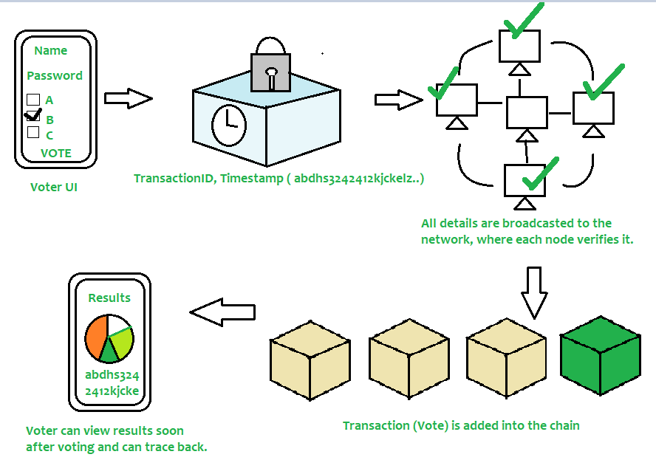
SYSTEM ARCHITECTURE
SYSTEM ARCHITECTURE

Slide 9
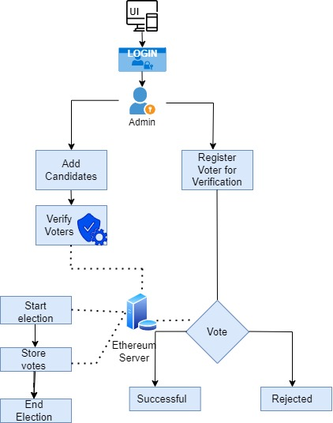
SYSTEM DESIGN

Slide 10
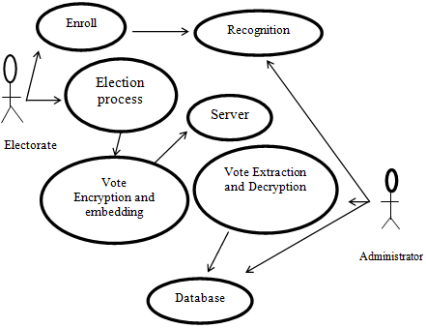
USE CASE DIAGRAM

Slide 11
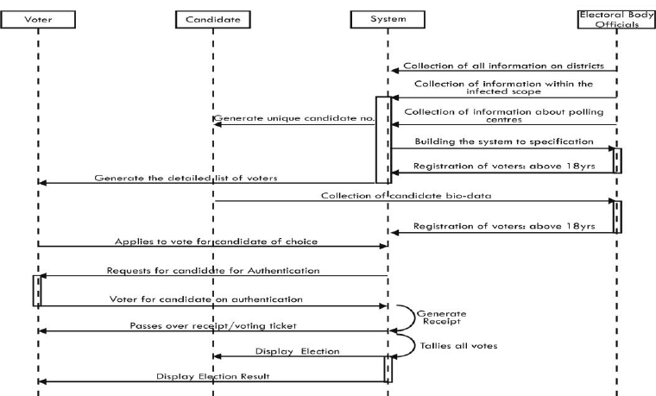
SEQUENCE DIAGRAM

Slide 12
LIST OF MODULES
Login
Initiating A New Ballot
Voting Process
Results

Slide 13
Unlike traditional web2 applications where the user logs in to their account using a username and a password, web3 applications use wallets to connect to a user account. The public key of an account uniquely identifies the user whereas the private key is used for authorization. In our voting process, we use meta mask wallet which is available as a browser extension. To log in, the user has to simply connect the app to an account from the wallet.
LOGIN

Slide 14
INITIALIZING A NEW BALLOT
Any user can start a new ballot by specifying the information regarding the ballot and by authorizing the transaction using the wallet.
The transaction is sent to the blockchain network and upon success is appended to the ledger permanently.
The ballot creator has to add a list of addresses (public address of user accounts) that are eligible to vote.

Slide 15
VOTING PROCESS
An user who is eligible to vote can connect their accounts in a similar manner using meta mask.
If the match is found, the voter is then presented with a list of available candidates with the option to cast vote against them. On the contrary, if the match is unsuccessful, any further access would be denied.
The user’s vote is recorded on the ledger as a transaction is sent to the network by signing a transaction in the wallet.
To this end, a successful vote cast is considered as a transaction within the blockchain of the voting application.

Slide 16
RESULTS
At the end of the specified ballot time, all users can view the results of the ballot.
A vote cast is added as a new block (after successful mining) in the blockchain as well as being recorded in data tables at the backend of the database.
The system ensures only one-person, one-vote (democracy) property of voting systems.
In the evaluation process, it was found that While sending the asset to the address, the transaction hash was generated carrying the transfer of vote.

Slide 17
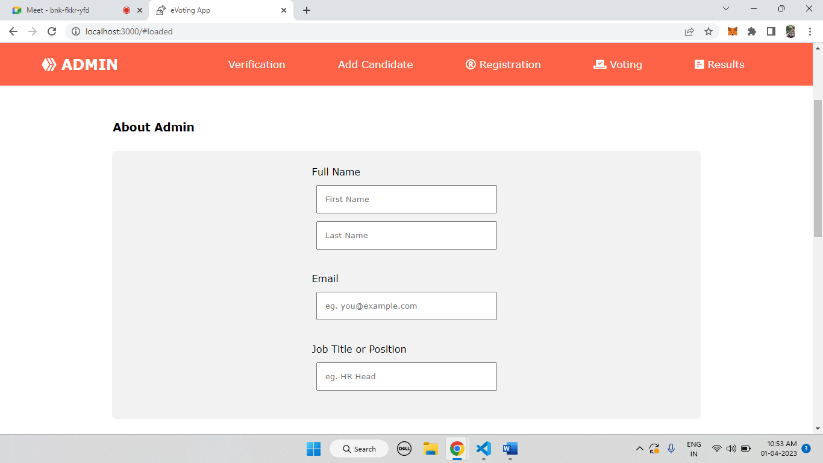
SCREENSHOTS

Slide 18
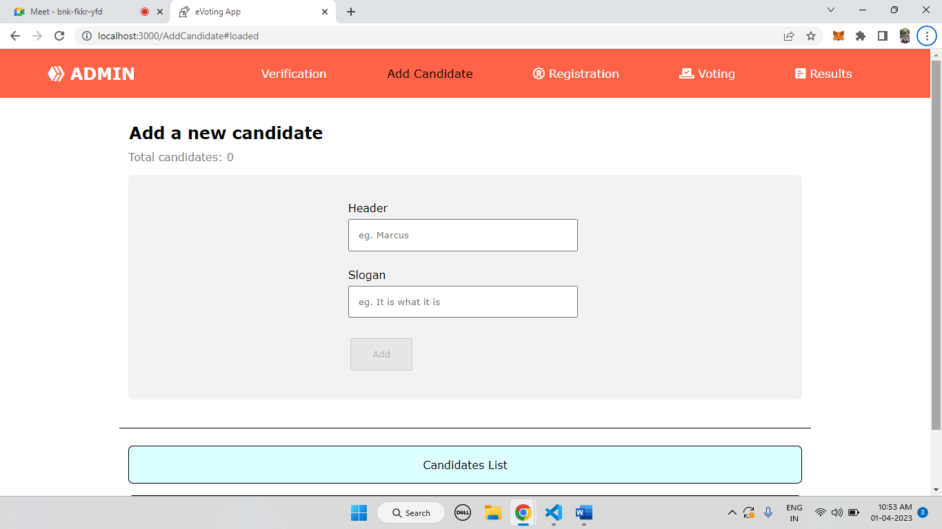
SCREENSHOTS

Slide 19
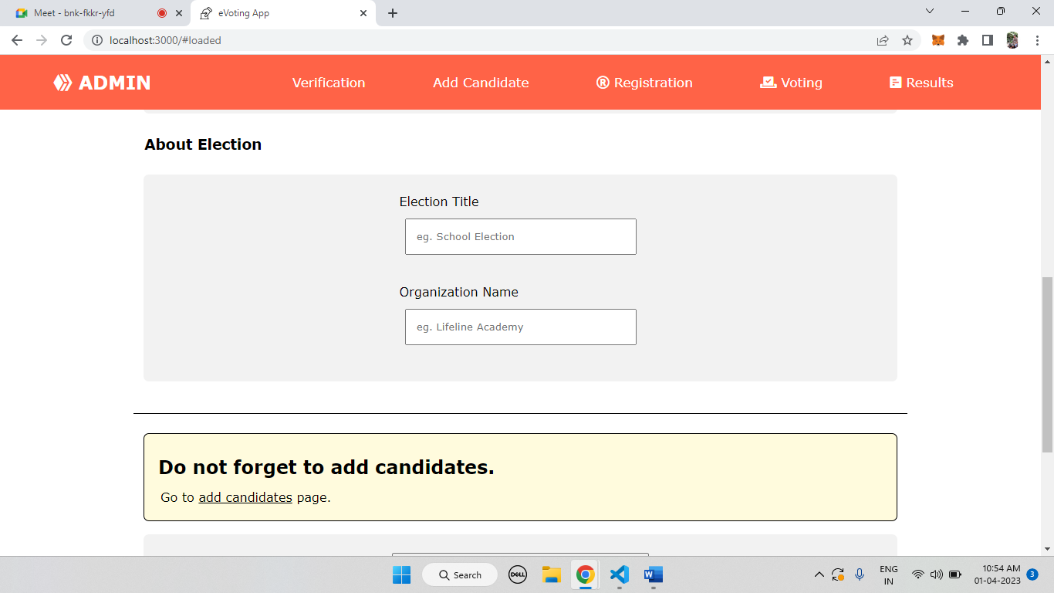
SCREENSHOTS

Slide 20
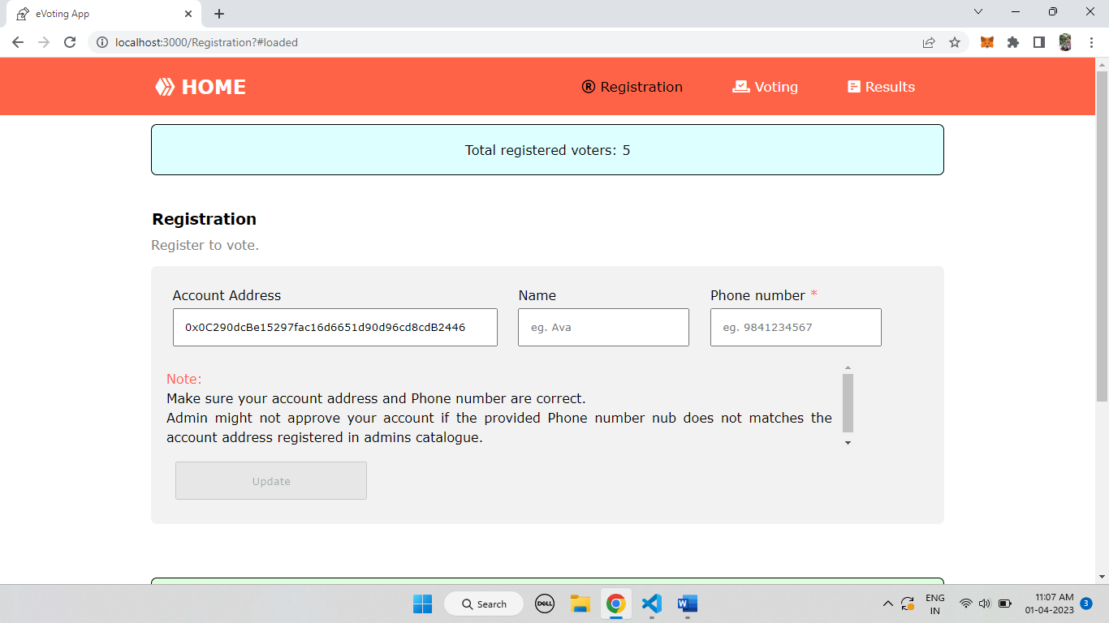
SCREENSHOTS

Slide 21
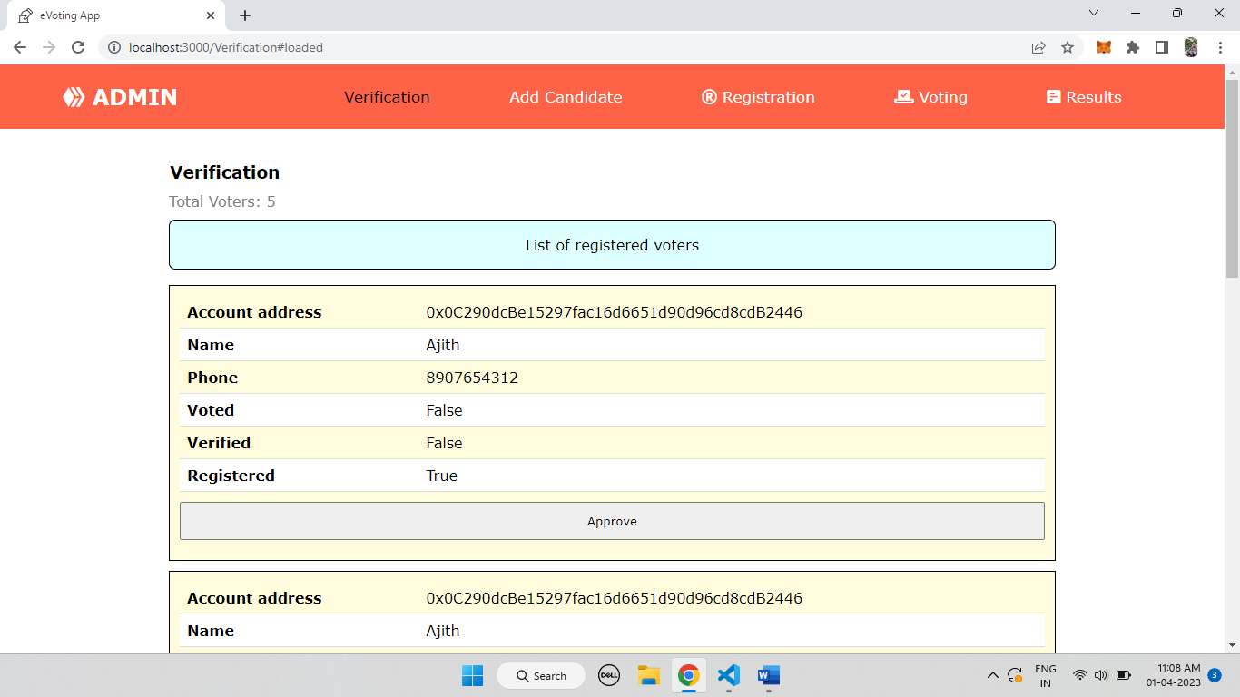
SCREENSHOTS

Slide 22
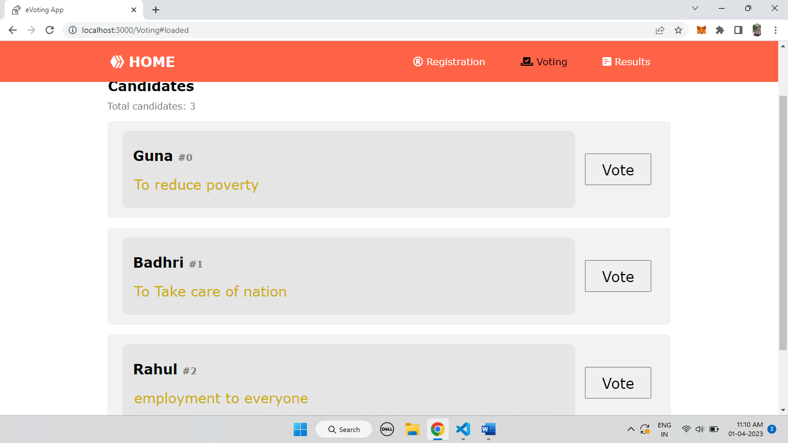
SCREENSHOTS

Slide 23
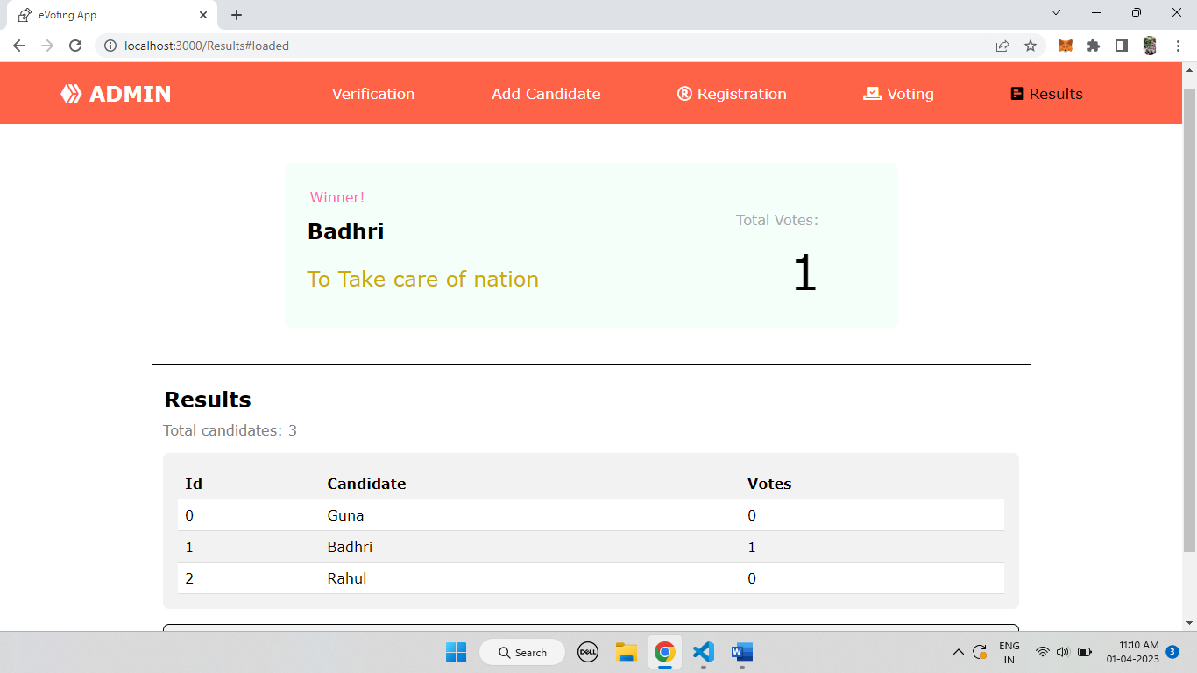
SCREENSHOTS

Slide 24
CONCLUSION
Decentralized online voting systems using blockchain technology have the potential to revolutionize the way we conduct elections and increase trust in the democratic process. By leveraging the power of distributed ledger technology, these systems can provide an immutable and tamper-proof record of all votes cast, which can greatly reduce the risk of fraud and manipulation.

Slide 25
REFERENCE
[1]Nakamoto Satoshi, Inventing bitcoin, implementing the first blockchain, deploying the first decentralized digital currency “A Peer-to-Peer Electronic Cash System” original 20 March 2020.
[2] Azaria, Asaph, Ariel Ekblaw, Thiago Vieira, and Andrew Lippman. "MedRec: Using Blockchain for Medical Data Access and Permission Management." In Open and Big Data (OBD), International Conference on, pp. 25-30. IEEE, 2019.
[3] Yaqoob, E. Ahmed, I. A. T. Hashem, A. I. A. Ahmed, A. Gani, M. Imran, Computer Networks: The International Journal of Computer and Telecommunications Networking,
[4] Nicole J. Goodman;Jon H. Pammett , “Internet Voting in a Local Election in Canada”, in Internet and Democracy in Global Perspective, Studies in Public Choice 31, Eds. Bernard Grofman, Alex Trechsel, and Mark Franklin, Springer Verlag.
[5] Guo, Ye, and Chen Liang. ”Blockchain application and outlook in the banking industry.” Financial Innovation 2, no. 1 (2016): 24.
[6]Ikhsan Darmawan E-voting adoption in many countries: A literature review,First Published October 12, 2021

Slide 26
THANK YOU

